Slide 1
THE CHESS
Submitted By:
S.M. Iqbal Morshed
Roll-39.
Abdullah Al Masud
Roll-93
Helal Uddin Hejazi
Roll-44.

Slide 2
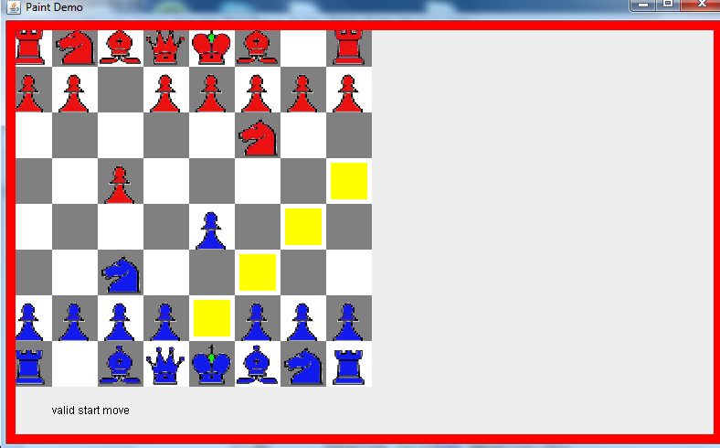
Introduction
Our project is a two palyer Chess game.
Two player has to maintain the rules and restrictions of the Chess game.

Slide 3
Algorithm Used In Chess Game
First of All, it takes the desired position to start with through mouse click.
Then the validity of this position is checked.
  If this position is valid then, all possible moves of the piece on this position is marked
  If this position is not valid then input is taken again.
After marking all possible moves, the destination point is taken through mouse click
  If this position is valid then, piece on this destination point is set.
  Otherwise, destination point is taken again.
This process is continued through alternate moves of black and white pieces.

Slide 4

Algorithm
X
X
X
X
X
X

Slide 5
Features
It has graphical user interface.
We can provide input through mouse.
Possible moves of a piece are shown through yellow colored box.
Valid / Invalid moves are told through a message.

Slide 6
Graphical Interface
After providing input
Press the “SOLVE”
Button to see output
Press “STOP”
Button if you don’t
Want to see output
The output box
Press “F” to take
Input from file
The Input box
Press “C” to clear
The input

Slide 7
Packages Used
For graphical works we used packages
  javax.swing.*;
  java.awt.*;
For mouse action listening we used
  java.awt.event.*;

Slide 8
Drawbacks
Can not be played in LAN
It can not handle King check

Slide 9
Future Plan
Our future plan is to add Artificial Intelligence to this game.
There will be different levels of difficulty.
Develop GUI.

Slide 10
Thanks to all

